Slide 1
Telemedicine
The Opportunity in Urgent Care
Presented at:

Slide 2
Urgent Care:
Market opportunity for Telemedicine
9000 urgent care centers nationwide; 160M annual visits*
Urgent care center could handle 13 - 27 % of all ED visits*
Urgent care heading toward goal of reducing health care spending annually by $4.4 B*
*Source: Convenient Care: Retail Clinics and Urgent Care Centers in New York State published by United Hospital Fund
Published: 02.05.2015

Slide 3
HEALTHePRACTICES Urgent Care Survey – Fall 2014
Sent to 930 urgent care centers; completed by 4%
Good mix of urban, suburban and rural centers
Includes all regions of the United States
Respondents included several of the largest urgent care chains as well as single site centers
Follow up interviews with 5 respondents

Slide 4
Finding # 1: 97% use Teleradiology
Teleradiology: first telemedicine service to achieve commercial success
Urgent care use of teleradiology does not
necessarily lead to other telemedicine services
Will teleradiology be a model for other TM services?
Leading provider for urgent care serving over 500 centers

Slide 5
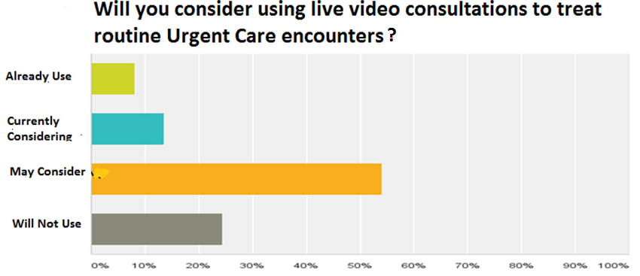
Finding # 2: Only 24% of Urgent Care Centers Will Not Use Telemedicine
Routine encounters include sinus, UTI, pulmonary procedures

Slide 6
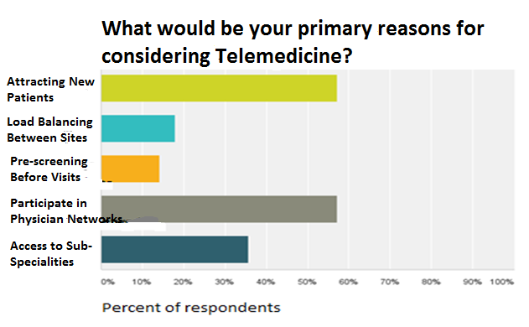
Finding # 3: Would Use Telemedicine to attract patients, join networks
Primarily a tool for revenue enhancement rather than cost savings

Slide 7
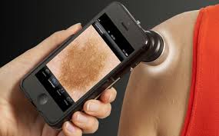
Finding # 4: Some interest in specialty services
Which specialty would you use or consider?
24% - Dermatology
14% - Psychiatry
11% - Neurology
“Specialty consultation may be a great idea, but a lot of doctors won’t admit that they don’t know something.”
MD/Owner of two northeast urgent care centers

Slide 8
Finding # 5: No Telemedicine provider dominates this market
No providers reaches 20% name recognition; leaders are:
Companies raised more than $20M each in 2014; suggests resources available to enter market

Slide 9
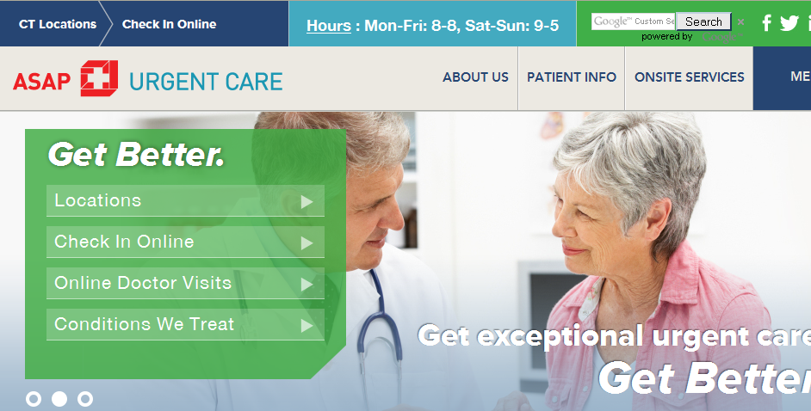
Urgent Care Offering Telemedicine Now
Chain of Four Urgent Care Centers in Connecticut

Slide 10
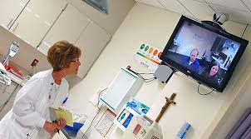
Conclusion: Not if, when...
“In the not too distant future, a patient walks into my center with a difficult condition. Rather than immediately referring that patient to a specialist, I can “click on the wall” and be presented with either a list of specialists I know, or a network of doctors who are immediately available for a consultation. I click on the doctor and we are soon engaged in a three-way consultation with the patient. This will result in increased patient satisfaction, and I know the patient will be back some time again and probably refer me to friends and family.”
MD/Owner of single Urgent Care Center on the West Coast

Slide 11
For additional information…
Howard Reis, President
HEALTHePRACTICES
845-392-2915
hreis@healthepractices.com
www.healthepractices.com

